Slide 1



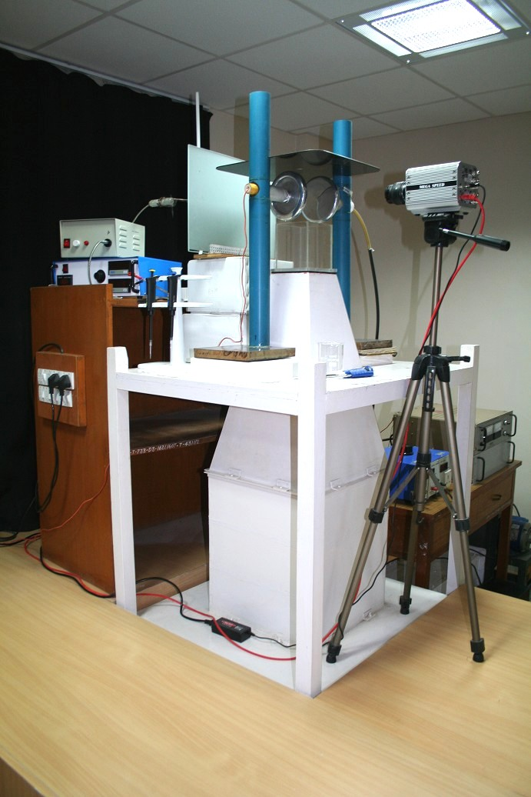
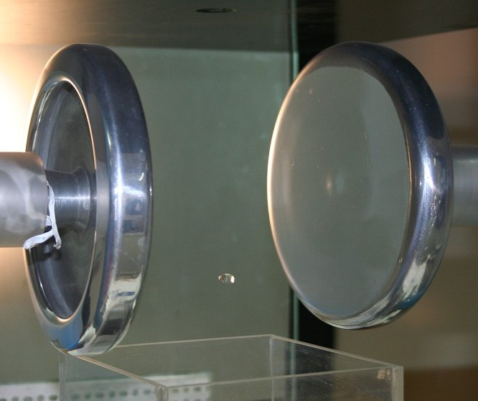
A wind tunnel study of collision-induced breakup of water drops in presence of electric field using high-speed video photography
Rohini Bhalwankar, Vidya S. Pawar, C.G. Deshpande and A.K. Kamra
Indian Institute of tropical Meteorology, Pune, India
Objective
To study the effect of electric field on outcome of collisions between drop pairs using high-speed photography from precipitation microphysics and electrification perspectives.
Results
a)
Background
Collision of two water drops may result in three outcomes: coalescence, break up, or bounce off of the colliding drops.
In warm clouds, first two processes are considered as the main driving mechanisms as they directly influence the growth and evolution of size distribution of raindrops.
The strong electrical force acting on the surface of drops located in the high-ambient electric field regions of a thundercloud also known to significantly influence the microphysical properties.
b)
c)
Instrumentation
Sequence of high speed images showing (a) filament type; (b) sheet type;
(c) disk type of breakup of drop pair (d_{L}= 3.2 mm; d_{S}= 1.2 mm)
in the presence of electric field of 300 kVm⁻¹.
Time shown indicates the evolution of breakup in ms.
Collision-induced breakup of water drops were carried out in a small, low turbulence vertical wind tunnel - a unique facility at IITM.
A larger drop (d_{L}= 3 - 3.5 mm diameter) was freely floated at its terminal velocity.
Smaller drops (d_{S}=0.6 -1.8 mm diameter), injected into the flow upstream of larger drop, were carried upward with the air stream to collide with the suspended drop in absence/ presence of horizontal electric field.
Results
Drop collision is governed by two competing energies: surface energy and collision kinetic energy. If collision has sufficient kinetic energy to overcome the surface tension forces, then drop breakup occurs.
Our preliminary results show that the number of collisions resulting in coalescence to the total collision number decreased from ~30% to 21% and the number of collisions resulting in breakup of the coalesced drop increased from 70% to 79% when the electric field increased from 0 to 300 kVm⁻¹.
In consistence with Low and List(1982a) our experiment three types breakup were classified from photographic evidences; i) Filament-type; ii) sheet-type; iii) disk-type.
A vertical wind tunnel
horizontal electric field arrangement
and a high speed camera
A high-speed video camera captured the sequence of drop collision process with a time interval of 1ms and provided information on the time evolution of drop collision outcomes.
From the comprehensive analysis of the captured images, the most important parameters utilized in numerical models, such as coalescence and breakup efficiency, breakup type, number of fragments and fragment size distribution after breakup were determined.
Significance of Drop Breakup in Thunderclouds
Collision- induced breakup process - the overwhelming cause of drop breakup in cloud - modifies number, size and charge distribution of drops, affecting the initiation and formation of rain by collision-coalescence in thunderclouds.
Electric forces inside strongly electrified cloud can modify rain DSD significantly.
The change in the size distribution of cloud drops may modify the radar echo – precipitation relationships in regions of thunderclouds with electric field.
Bibliography
Low, T.B., List, R., (1982a) Collision, coalescence and breakup of raindrops. I: experimentally established coalescence efficiencies and fragment size distributions in breakup. J. Atmos. Sci. 39 (7), 1591–1606.
Rohini Bhalwankar, C. G. Deshpande and A K Kamra, (2017) Breakup modes of the drops suspended in a vertical wind tunnel in presence of the horizontal electric field, J. Geophys. Res. Atmos., 122, 1838–1849, doi:10.1002/2016JD025805
Miklós Szakáll, Isabel Urbich, (2018) Wind tunnel study on the size distribution of droplets after collision induced breakup of levitating water drops, Atmos.Res., 213, 51-56, https://doi.org/10.1016/j.atmosres.2018.05.007
Next step…
To determine the Fragment Size Distribution in breakup from the present dataset
and compare with the parameterizations of Low and List (1982).
To conduct different experiments including charged drops and in presence of
higher electric fields.
RAC Meeting, February 21, 2020, IITM, Pune

